Slide 1
Using BRIDG to Connect to Healthcare Standards
Smita Hastak
Samvit Solutions/NCI
October 16th, 2019
CDISC Interchange, San Diego, CA

Slide 2
Agenda
Objective of the presentation
What is Data Model?
BRIDG Model Overview
Scope
BRIDG Model Implementation Approaches
BRIDG & CDISC
BRIDG and HL7 FHIR
Summary

Slide 3
Objective of the presentation
To provide a high level overview of the BRIDG Model
To highlight why a data model might be useful
To illustrate how BRIDG could be considered as a hub for semantic foundation across various standards
Connector to healthcare standards

Slide 4
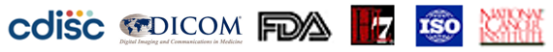
BRIDG Overview
BRIDG - Biomedical Research Integrated Domain Group
It is UML class diagram or a data model
Referred to as “BRIDG Model”
A collaborative effort to represent the semantics of clinical and translational research
The stakeholders of BRIDG are CDISC, FDA, HL7, ISO and NCI
Goal: To produce a shared view of the semantics of basic, pre-clinical, clinical and translational research and their associated regulatory artifacts (collectively called translational research).

Slide 5
What is a Data Model?
A visual representation that organizes data elements and standardizes how these data elements are related to each other.
Data elements are properties about entities – e.g., Person name, DOB, Street address, Study Phase, Study Title, etc.
Data models represent discrete facts about entities - people, places, things, activities and relationships
They are built to represent the data needs/requirements of a domain of interest
Clinical Trials, Imaging, Genomics, Specimen, etc.
Various types of data models
Conceptual, Logical, Physical

Slide 6
Data Model Example
Relationship
CDISC SDTM: LB.USUBJID
Data Elements/
Properties/
Attributes
Entity/Class

Slide 7
Why do you need a Data Model?
Since data model represents the data needs of the domain of interest, they provide a common reference and standardization of the business data
Provides common framework for all business stakeholders
Standardization of these data elements provide the consistent semantics (meaning), structure and format to support the data needs
Definitions, text/numeric, multiplicity, valid values, business rules, etc.
Process of analyzing the business data needs allows for identification of common data elements and consistent representation
Reduces ambiguity, removes overlapping semantics, etc.

Slide 8
Types of Data Models
Conceptual
Abstract model that identifies and defines the key high level concepts of the business and their inter-relationships
Logical
Derived from the Conceptual model – fleshes out the details of each business concepts by developing the attributes/data elements, data format, multiplicity, etc.
Physical
Derived from the Logical model for developing a relational database design.
Tables, columns, etc.
Notes:
BRIDG model straddles between Conceptual and Logical layer

Slide 9
BRIDG Model

Slide 10
BRIDG Overview
This common domain model is represented as a UML class diagram and maintained in Sparx Systems - Enterprise Architect tool
Hybrid conceptual/logical model – parts of the model are very granular and others parts are abstract. Can be extended to add more granularity depending on the requirements/use cases.
Model is organized into “Views” that support specific projects or use cases
These views display subset of BRIDG classes, attributes and associations
Provides rigorous definitions for translational research concepts and their relationships to each other
BRIDG is a platform-independent model – can be implemented in many different ways
Can be leveraged:
As a domain information model to develop detailed design artifacts
such as database designs, APIs, data exchange formats, etc.
As system integration platform to integrate disparate systems through a standard model
The common semantics across the various solutions could provide the framework to enable semantic interoperability.

Slide 11
BRIDG Overview (continued)
Started with clinical trials focus; Inclusion of life sciences concepts expanded the scope to include translational research about 4 years ago
Expansion to Imaging about 2 years ago
Balloted periodically by 3 different Standards Development Organizations (SDOs): HL7, CDISC, ISO
BRIDG is an ISO Standard – ISO 14199
HL7 Standard - Biomedical Research & Regulation (BR&R) WG
BRIDG website: https://bridgmodel.nci.nih.gov/
BRIDG model development is supported by the NCI
Mapping and modeling services
Model management
Website design & hosting

Slide 12
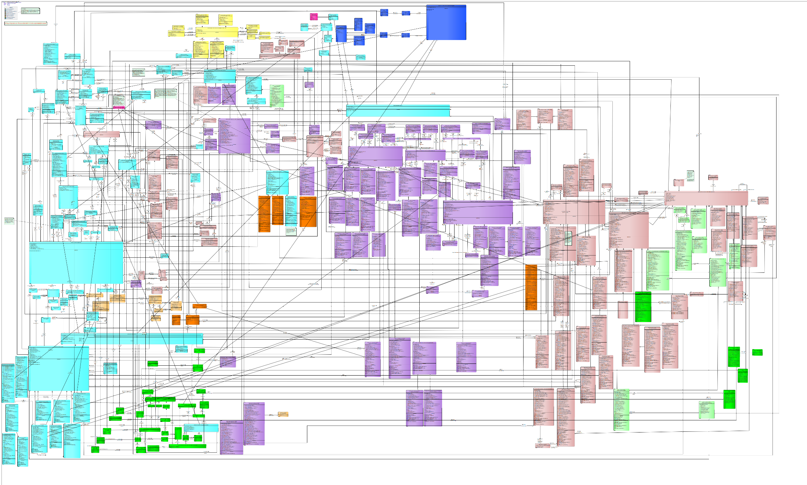
Study Protocol
Study Subject
Activities
Person
Observation
Results
Study Site
Observations
Organization
Study Agent
Product

Slide 13
Topic/Areas covered in BRIDG
BRIDG model includes concepts from a variety of sub-domains of clinical and translational research, e.g
Protocol Representation (Trial Design, Study objectives, etc.)
Study Conduct/Execution (Study Subject, Study Sites, Study activities, Observations, Results, Procedures, etc.)
Imaging (based on DICOM - Imaging Study, Measurements & Annotations, Devices, CT/MR/PET specifics, etc.)
Oncology (Disease Response, Tumor identification, Lesion Evaluation, etc.)
CDISC SDTM (covers all domains/variables of SDTM IG 3.1.3)
Adverse Event (AE, AE Outcome Result, AE Seriousness, etc.)
Biospecimen (Specimen, Specimen Collection Protocol, Specimen Processing, etc.)
Molecular Biology (high level concepts of Gene, Biomarker, Chromosome, Genome, Pathway, etc.) – high level only
NOTE: Some of the Molecular Biology semantics are planned to be deprecated from BRIDG since the HL7 Clinical Genomics group is building a model.

Slide 14
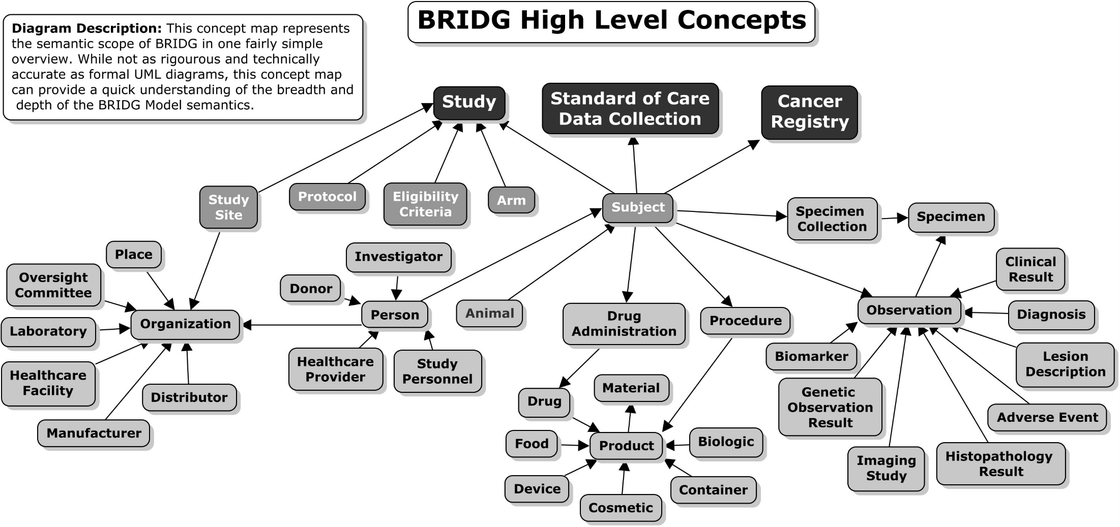
BRIDG High Level Concepts
Note: This is NOT a BRIDG Model representation. This representation was just created for this presentation to show the kinds of information available in BRIDG

Slide 15
Standards & Projects Mapped to BRIDG
Harmonization of new semantics from stakeholder projects
Bottom up modeling approach
Many project semantics mapped to BRIDG
Some represented as BRIDG Views
Semantics from
CDISC
CDISC SDTM IG v3.1.2, v3.1.3, and v3.2
CDSIC Lab v1.0.1
CDISC PGx IG r1.0
CDISC CDASH v1.1
CDISC TDM
Other standards
ClinicalTrials.gov
CDMH – FDA’s Common Data Model Harmonization
SEER – NCI Surveillance, Epidemiology & End Results
NBIA – National Biomedical Imaging Archive
APSR – IHE’s Anatomic Pathology Structured Report
DICOM – SR TID 1500, Suppl 121
OMOP Common Data Model – Observational Medical Outcomes Partnership
Sentinel
PCORNet – National Patient Centered Clinical Research Network
etc.
Notes:
Sentinel is the FDA’s national electronic system which has transformed the way researchers monitor the safety of FDA-regulated medical products, including drugs, vaccines, biologics, and medical devices. In response to the FDA Amendments Act (FDAAA) of 2007, in May 2008 the FDA launched the Sentinel Initiative.

Slide 16
SDTM IG v3.2 Domains Mapped to BRIDG
AE – Adverse Events
CE – Clinical Events
CM – Concomitant & Prior Medications
CO – Comments
DA – Drug Accountability
DD – Death Details
DM – Demographics
DS – Disposition
DV – Protocol Deviations
EC – Exposure as Collected
EG – ECG Results
EX – Exposure
FA – Findings About
HO – Healthcare Encounters
IE – Inclusion and Exclusion Criteria Not Met
IS – Immunogenicity Specimens
LB – Laboratory Test Results
MB – Microbiology Specimen
MH – Medical History
MI – Microscropic
MO - Morphology
MS - Microbiology Susceptability
PC – Pharmacokinetics Concentrations
PE – Physical Exam
PP – Pharmacokinetics Parameters
PR – Procedure
QS – Questionnaire
RP – Reproductive Systems Findings
RS – Disease Response
SC – Subject Characteristics
SE – Subject Elements
SR – Skin Response
SS – Subject Status
SU – Substance Use
SV – Subject Visits
TA – Trial Arms
TD – Trial Disease Assessments
TE – Trial Elements
TI – Trial Inclusion/Exclusion Criteria
TR – Tumor Response
TS – Trial Summary Information
TU – Tumor Identification
TV – Trial Visits
VS – Vital Signs

Slide 17
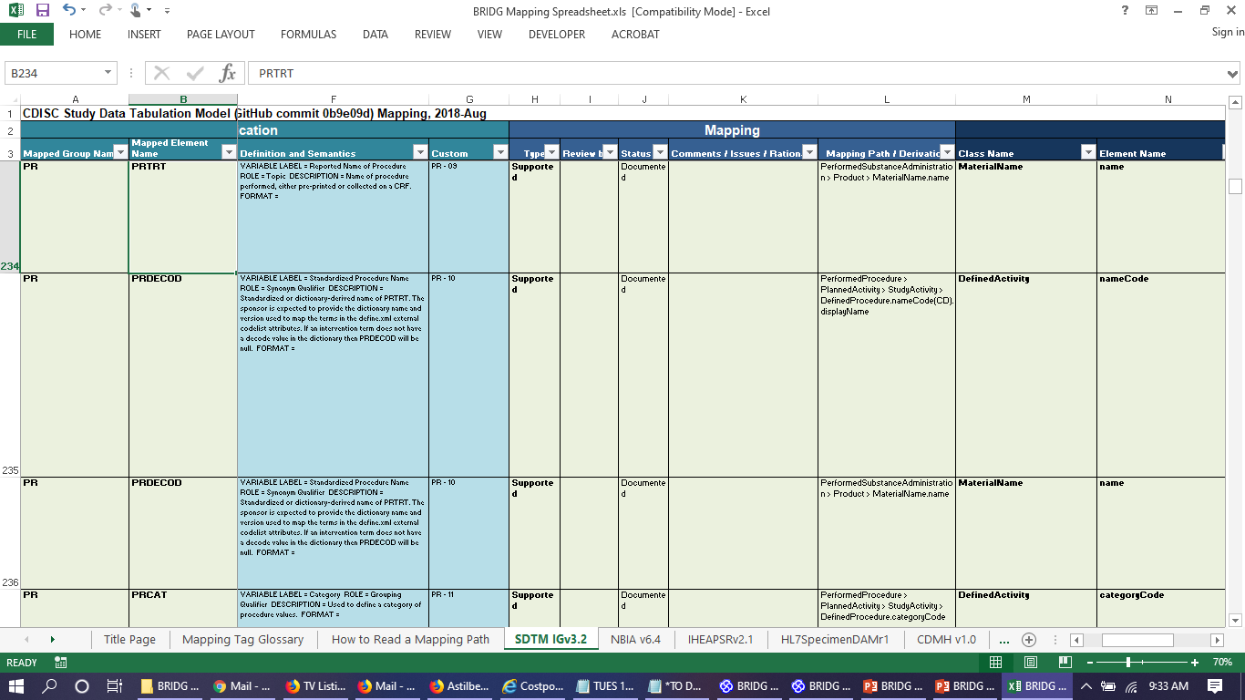
Sample BRIDG Mapping Spreadsheet (SDTM)
SDTM Variables & Metadata
Mapping Process Support
Mapped BRIDG Concepts
SDTM Data Element Name,
Data Type, Cardinality,
Definition and Semantics
Mapping Type, Review By,
Status, Comments/Rationale,
Mapping Path/Derivation
Class, Attribute/Assoc,
Data Type, Carinality,
Definition/Ex/Notes

Slide 18
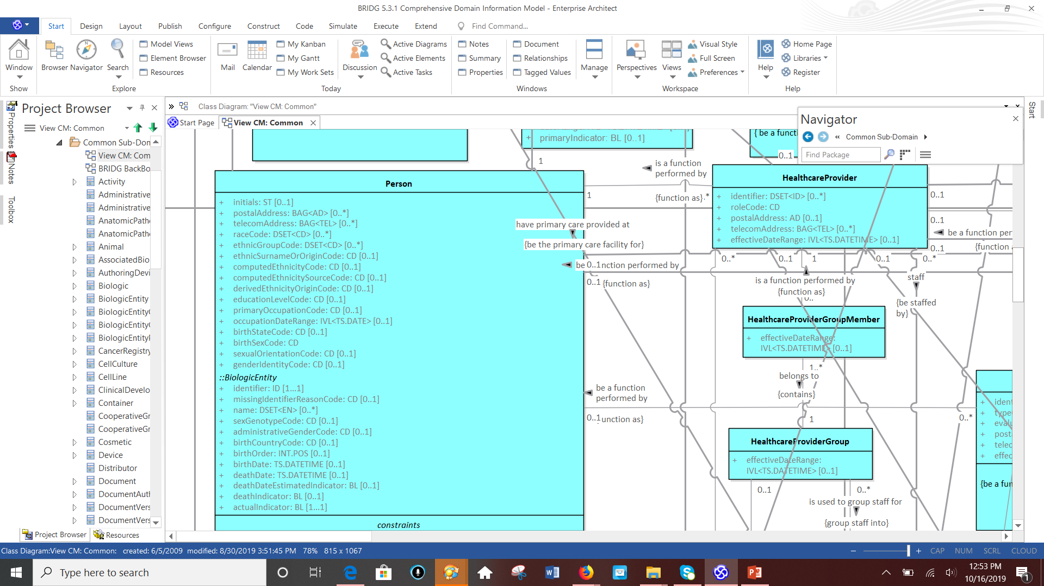
Person Class in BRIDG
EthnicGroupCode

Slide 19
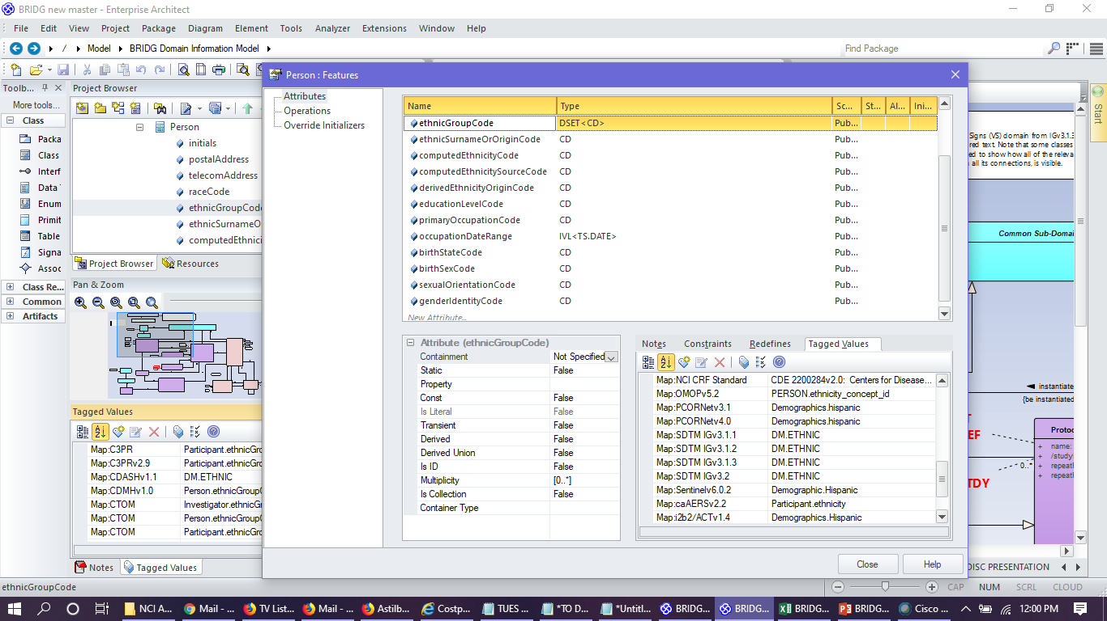
Example of mapping tags are captured in BRIDG
Mapping tags capture the provenance of each semantic that has been mapped to BRIDG and are curated as the model matures and grows.

Slide 20
Data Model Example
Relationship
Data Elements/
Properties/
Attributes
VS.USUBJID
Subclass (subtype)
VSDTC
VSRFTDTC
VSDY
VSSTAT
VSREASND
VSTEST
VSTESTCD
VSCAT
VSSCAT
VS.VISIT
VSTPTREF
VS.VISITDY
Entity/Class

Slide 21
BRIDG Implementation Approaches
Reference Model
Source for clinical research data semantics & foundation model
Data Integration/Mapping Solutions
One mapping to a standard rather than multiple point to point mappings
Exchange Format
Subsets of BRIDG classes represented in XSD/XML
Physical Database
Create logical and physical database models in support of clinical research software solutions
NMDP, Thomas Jefferson University, Large CRO, FDA, etc.
Ontology
To develop clinical research ontology

Slide 22
BRIDG as “Hub & Spoke” – Data Integration Approach -- “Connector to Healthcare Standards”
SEER
NBIA
CDISC
SDTM
AIM
HL7
FHIR
DICOM
OMOP
PCOR
net
GDC-Clinical
CT.gov
APSR
BRIDG Mappings:
Green – Standards
Blue – healthcare projects/
Models….many
others not listed here
BRIDG
Model

Slide 23
Why consider BRIDG as a “Semantic Hub”?
Supported by CDISC, FDA, HL7, NCI, ISO
ISO, CDISC and HL7 Standard
Mapped to many different research models and standards – Take advantage of the mappings, etc.
CDISC SDTM, SEER, DICOM (partial), CIBMTR/NMDP, CT.gov, NBIA, AIM, CDMH (PCORNet, Sentinel, OMOP, ACT/I2B2)
Allows for cross walking between the mapped semantics
Removes the need for point-to-point mappings
Conceptual meaning of classes and attributes of BRIDG are annotated and registered in caDSR using NCIt standard terminology concepts
NCIt:
Source of truth for CDISC terminology
Source of truth for FDA terminology
Linked to UMLS CUIs
Preferred terminology for NCI
Not bound to any coding system
Allows us to link together fields in different systems that are semantically the same but coded differently
Provided the semantic foundation for the HHS cross-agency project – CDMH (NCI, FDA, NCATS, NLM, ONC)
Credit: few bullets from Denise Warzel

Slide 24





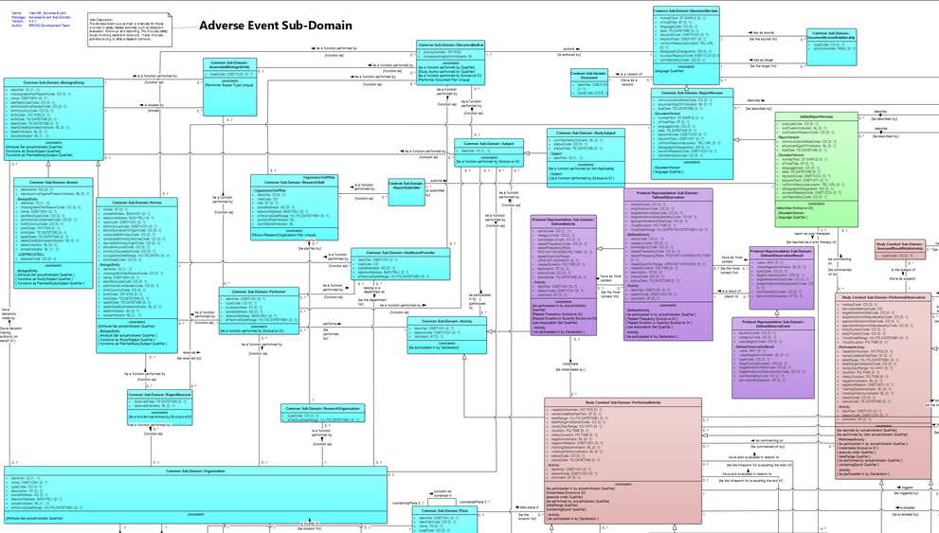
FDA CDMH Database Example – Physical DB and Data Integration Approach
Physical Models
1
Mappings
Conceptual Model
2
CDMH
BRIDG View
(Subset of BRIDG Classes PLUS
New semantics from 4 models)
3
BRIDG-Based
Logical Model
CDMH
Logical Model
5
4
Physical Models
Bidirectional Mappings
CDMH Repository
BRIDG-Based
Physical Model
Source: FDA CDMH Project

Slide 25
Known BRIDG Implementations
US FDA – The Clinical Trials Repository
US NCI
Thomas Jefferson University
National Marrow Donor Program (NMDP)
Large CRO
Couple of large Pharmaceutical Companies
Few small bio-tech firms
Note: The interest in BRIDG from pharmaceutical companies is because of the mappings to various other efforts – mainly CDISC SDTM.
Go To BRIDG website – html version - https://bridgmodel.nci.nih.gov/

Slide 26
HL7 FHIR
BRIDG Model has been mapped to HL7 FHIR 3.0.1
These mappings are not in the BRIDG Model as yet
Work done as part of FDA U01 Grant to Samvit Solutions
BRIDG Model is being leveraged at HL7 Biomedical Research & Regulation (BR&R) WG as the semantic model
All new FHIR resources being developed by BR&R in support of Clinical Research are using the BRIDG Model semantics
ResearchStudy & ResearchSubject – FHIR Resources
BR&R recently balloted – CDISC Lab Semantics in FHIR
Other FHIR Resources of interest
Specimen, PlanDefinition, Observation, (CG Profiles), ImagingStudy, AE, etc.

Slide 27
Summary
BRIDG – a conceptual or domain information model for translational research
BRIDG covers many domains of healthcare
Clinical research, clinical care, imaging, oncology, specimen, etc.
BRIDG has been mapped to many different project metadata
SEER, OMOP, PCORnet, ACT/12b2, FDA Sentinel, NMDP, CT.gov, NBIA, AIM, etc.
BRIDG has been mapped to some standards
CDISC (SDTM, PGx, TDM, CDASH), HL7 FHIR, DICOM (where relevant)
BRIDG classes and data element meanings are registered in NCI caDSR using NCIt concepts
Mappings are captured in the model and can be leveraged to find equivalent mappings to other efforts/standards, thus connecting semantics and avoiding point-to-point mappings

Slide 28
Thank You!
BRIDG Contacts
Smita Hastak
hastaks@mail.nih.gov
Wendy Ver Hoef
verhoefw@mail.nih.gov

Slide 29
Backup slides

Slide 30
CDISC SDTM IG v3.2 Mapped Concepts in BRIDG

Slide 31
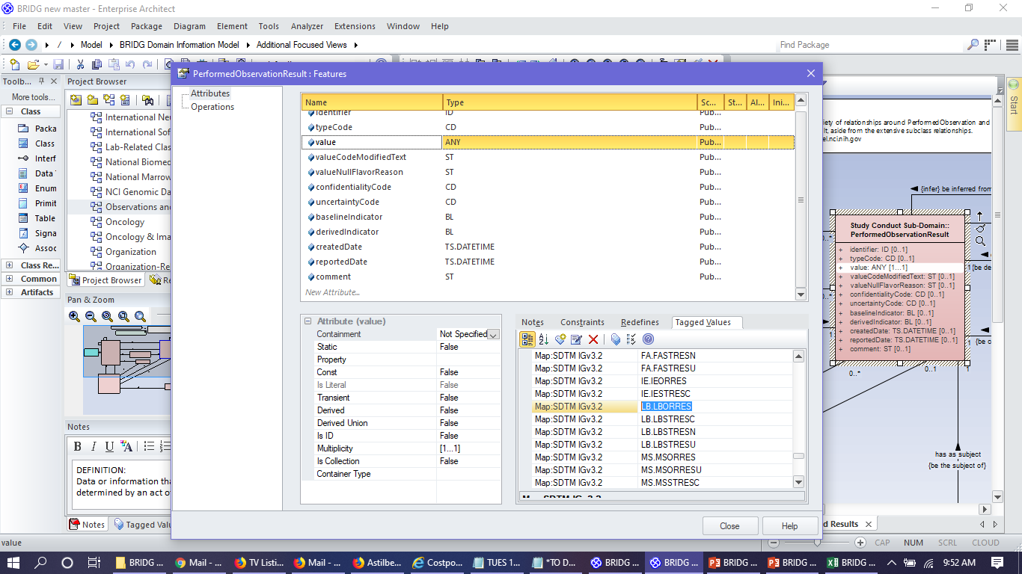
Example of mapping tags are captured in BRIDG
Mapping tags capture the provenance of each semantic that has been mapped to BRIDG and are curated as the model matures and grows.

Slide 32
CDSIC Lab Data Model Concepts in BRIDG

Slide 33
CDISC Lab Data Model Detail View
BRIDG element definitions can be downloaded in Diagram Metadata Report
BRIDG elements tagged with CDISC Lab Data Concept labels

Slide 34
SDTM Exposure (EX) Domain

Slide 35
SDTM Disease Response (RS) Domain

Slide 36
SDTM Vital Signs (VS) Domain

Slide 37
How to use a Data Model?
Data Models can be used in many different ways
To provide a common semantic framework in a domain of interest
To develop database designs
Allows tracing business requirements to implementation
To validate data quality
To enforce data formats

